Slide 1



HR Analytics Employee Retention
Presented by Group 1

Slide 2
Agenda
Introduction
Objective
Dashboards
KPIs Insights
Timeline
Area of Focus
Summary

Slide 3

Introduction
This project is all about analysis of data for employee attrition in an organization and the analysis is from the prospective of the HR department of the organization. This HR analytics project is aimed at providing HR managers and business leaders a comprehensive way to analyze and monitor employee data, and make data-driven decisions related to employee retention, development, and recruitment.
This help HR managers track progress toward reducing attrition. The chart includes legends and interactive filters to allow HR managers to drill down and explore the data further.
3

Slide 4






Technology used

Slide 5
DATA CLEANING:
Open Dataset in Excel and Make a Copy of Dataset for security purpose.
Remove Duplicates.
Change the formatting of necessary columns.
Spell Check.
Change Case - Lower/Upper/Proper.
Trim the unwanted spaces.
Remove null values if its not going to affect the result.
Find & Replace.
5

Slide 6
Thorough understanding of the attrition trends.
To identify patterns and potential factors that contribute to attrition.
Potential implications and strategies for addressing attrition.
Building dashboard - will elevate simple metrics, by linking them to one another and visualizing them as a whole.
Objectives

Slide 7
KPIs
Average Attrition rate for all Departments
Average Hourly rate of Male Research Scientist
Attrition rate Vs Monthly income stats
Average working years for each Department
Job Role Vs Work life balance
Attrition rate Vs Year since last promotion relation
7

Slide 8
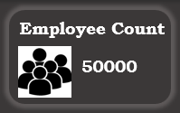
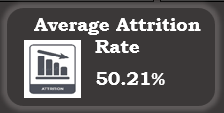
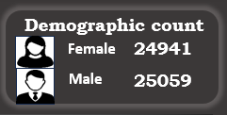
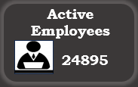
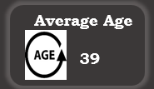
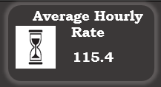
HR analytics Employee Retention Project
There were 24941 females and 25059 males among a total of 50000 employees.
Out of these 50000 employees, 25105 decided to leave the organization, while 24895 are the active employees.
The company experienced an overall attrition rate of 50.21%.
The average hourly rate is 115.4 while maximum hourly rate is 200.
The average age of employees is 39.
8

Slide 9
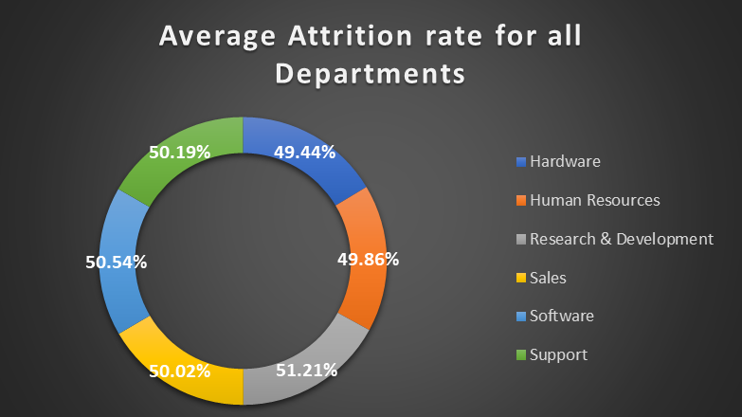
1.Average Attrition rate for all Departments
The chart shows the average attrition rate (employee turnover) for different departments.
The rates across departments are fairly close, with all hovering around 49-51%.
Hardware: 49.44%
Human Resources: 49.86%
Research & Development: 51.21% (highest)
Sales: 50.02%
Software: 50.54%
Support: 50.19%
Insight: Employee turnover is quite balanced across departments, with R&D having the highest attrition rate and Hardware the lowest, though the difference is marginal.
9

Slide 10
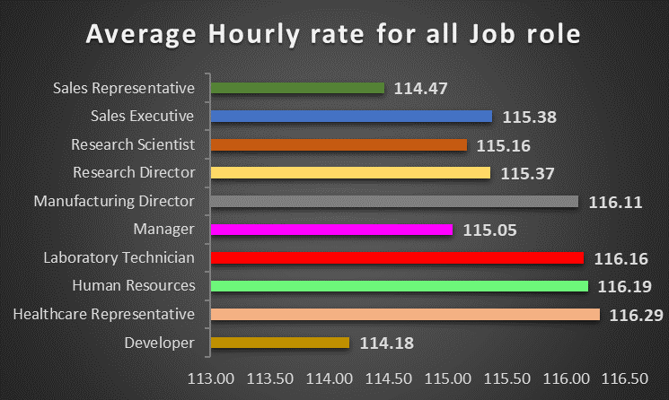
2.Average Hourly rate of Male Research Scientist
This graph shows the average hourly rate for various job roles.
The highest average hourly rates are in:
Healthcare Representative: 116.29
Human Resources: 116.19
Laboratory Technician: 116.16
The lowest hourly rates are in:
Sales Representative: 114.47
Developer: 114.18
Insight: Healthcare and HR roles offer the highest hourly compensation, while sales roles tend to be on the lower end of the pay scale.
10

Slide 11
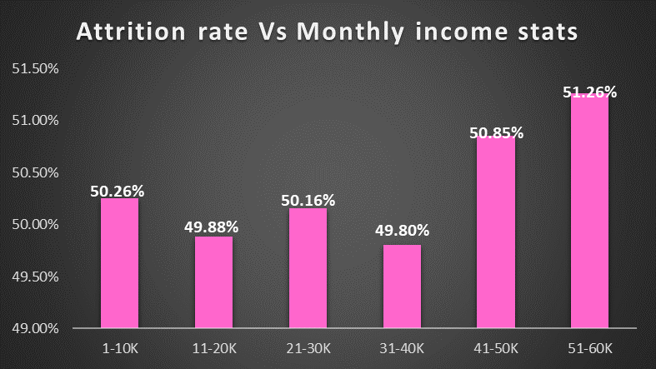
3. Attrition Rate vs. Monthly Income
This chart compares attrition rates across different income brackets (1-10K, 11-20K, etc.).
Employees earning between 51-60K have the highest attrition rate at 51.26%.
Employees earning between 11-20K and 31-40K have the lowest attrition rates, around 49.88% and 49.80% respectively.
Insight: Attrition seems to increase in the higher income brackets, possibly indicating that higher earners have more options for movement or dissatisfaction despite higher pay.
Overall Insights:
Attrition is fairly stable across departments but tends to spike slightly in certain income brackets.
Higher earners, especially those in the 51-60K range, exhibit higher turnover.
Some roles, particularly healthcare and human resources, offer higher hourly wages, which could influence satisfaction and turnover trends.
11

Slide 12
4. Attrition Rate vs. Monthly Income
The chart titled "Average Working Years for Each Department" presents a breakdown of the average tenure of employees across various departments within an organization.
The data reflects the following average working years for each department:
Hardware: 20.48 years
Human Resources: 20.45 years
Research & Development: 20.62 years
Sales: 20.30 years
Software: 20.65 years
Support: 20.48 years.
This chart indicates that employees across all departments have a similar length of service, with only slight variations. The Software department shows the highest average tenure at 20.65 years, while the Sales department has the lowest at 20.30 years. This consistency across departments may suggest a stable and long-serving workforce.
12

Slide 13
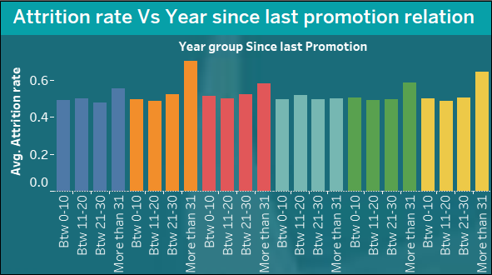
5.Attrition rate Vs Year since last promotion relation
The image displays a bar chart titled "Attrition rate Vs Year since last promotion relation." It shows the average attrition rate across different groups categorized by the number of years since the employees' last promotion.
Key observations:
The x-axis represents the number of years since the last promotion, broken down into intervals: "Btw 0-10," "Btw 11-20," "Btw 21-30," and "More than 31."The y-axis shows the average attrition rate, ranging from 0.0 to 0.6.
The bars are color-coded to represent different year groups, indicating how the attrition rate changes over time based on how long it has been since an employee's last promotion.
From the chart, we can observe that: Employees who have gone 31 or more years without a promotion tend to have the highest attrition rate.
In contrast, employees who have recently been promoted (within 0-10 years) exhibit relatively lower attrition rates. Attrition rates increase with time since the last promotion, peaking for certain year intervals before decreasing slightly for other groups. This chart suggests a direct relationship between time since last promotion and employee attrition, emphasizing the importance of timely promotions to retain employees.
13

Slide 14
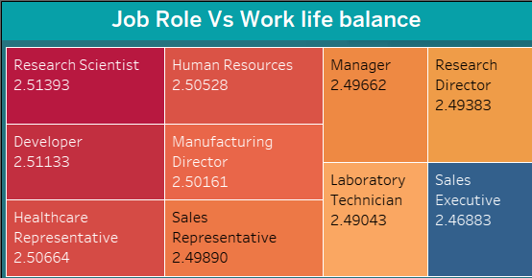
6.Job Role Vs Work Life Balance
The image shows a chart titled "Job Role Vs Work Life Balance," which compares different job roles based on a work-life balance score. Each job role is presented in a colored block, along with its corresponding work-life balance score. Here are the values for each role:
Research Scientist: 2.51393
Human Resources: 2.50528
Manager: 2.49662
Research Director: 2.49383 & so on.
14

Slide 15
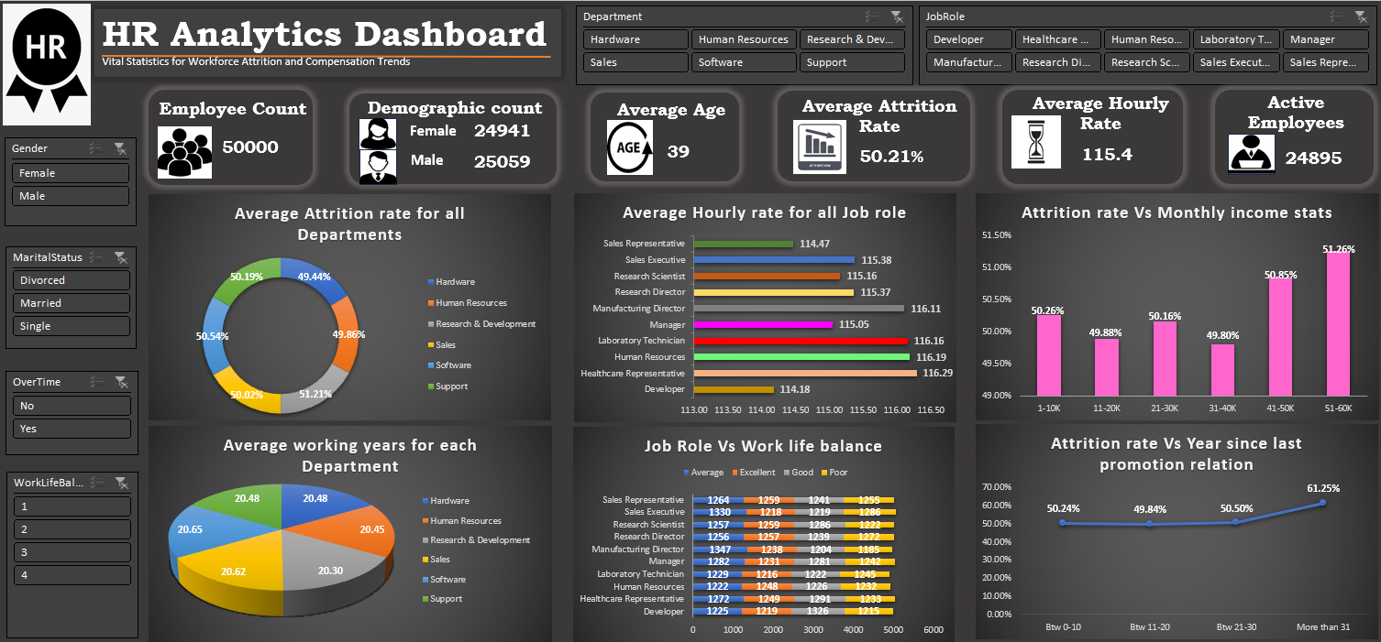
Excel Dashboard
15

Slide 16
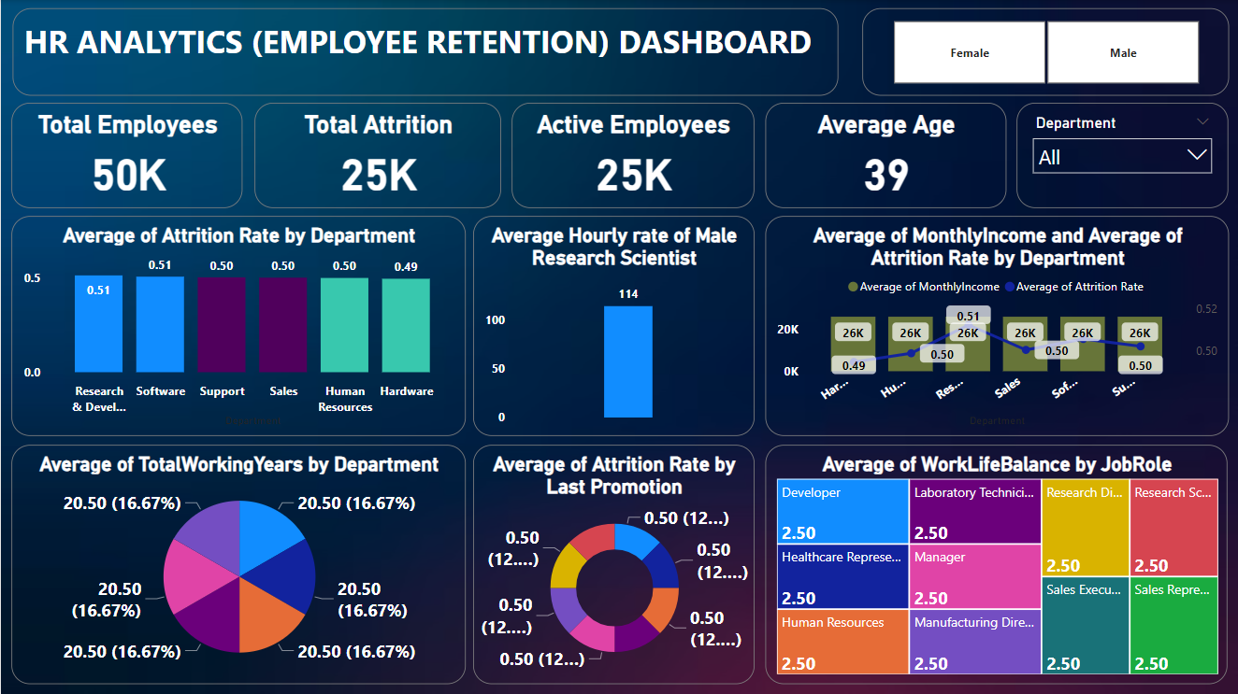
PowerBI Dashboard
16

Slide 17
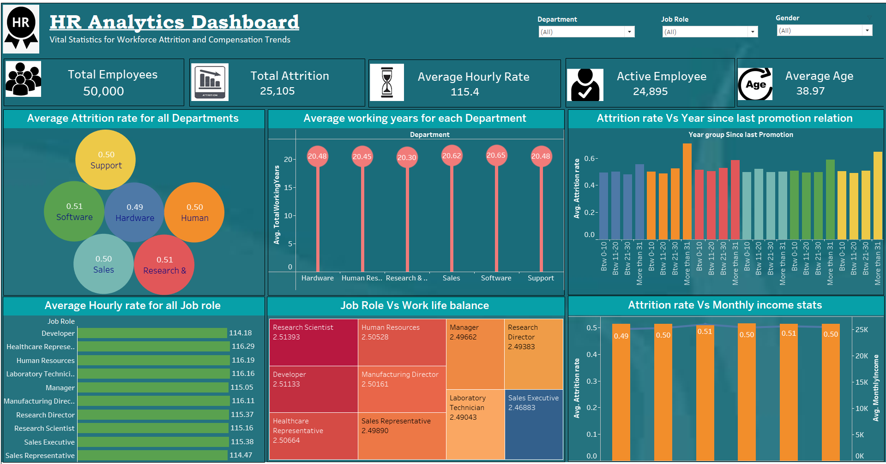
Tableau Dashboard
17

Slide 18
Timeline
26-08-2024
16-09-2024
Implementation of KPI’s using Excel & SQL
Final Presentation of the Project
19-08-2024
Project Kick-off Meeting
02-09-2024
09-09-2024
Implementation of KPI’s using Tableau
Implementation of KPI’s using Power BI
18

Slide 19

Areas of focus
1.Improve Recruitment and Onboarding: Ensure that the recruitment process aligns candidates’ skills and expectations with the job and company culture. Enhance the onboarding process to make new employees feel welcome, informed, and well-prepared for their roles.
2. Competitive Compensation and Benefits: Offer competitive salaries and benefits to attract and retain top talent. Provide performance-based incentives, bonuses, and recognition programs to motivate employees.
3. Employee Development: Invest in training and development programs to help employees acquire new skills and advance in their careers within the company. Promote a learning culture and provide opportunities for skill-building and growth.
4. Work-Life Balance: Encourage a healthy work-life balance to prevent burnout and maintain employee well-being. Allow for flexible work arrangements, remote work, and family-friendly policies.
5. Communication and Feedback: Maintain open and transparent communication between employees and management. Collect and act on employee feedback to address concerns and make necessary improvements.
6. Recognition and Rewards: Implement a robust recognition program that acknowledges and appreciates employees for their contributions. Create a positive work environment where employees feel valued.
19

Slide 20
Areas of focus
7. Career Advancement Opportunities: Offer clear career progression paths and opportunities for employees to advance within the company. Promote from within whenever possible to motivate and retain top performers.
8. Leadership and Management: Train and support managers to be effective leaders who inspire and motivate their teams. Ensure that managers are approachable and empathetic to employee needs.
9. Wellness Programs: Promote employee health and well-being through wellness initiatives, mental health support, and stress management programs.
10. Exit Interviews: Conduct meaningful exit interviews to understand the reasons for employee departures and identify areas for improvement.
11. Employee Engagement Surveys: Regularly measure employee engagement and job satisfaction through surveys to proactively address concerns.
12. Retention Bonuses and Incentives: Consider offering retention bonuses or incentives to employees who have been with the company for a certain duration.
13. Talent Analytics: Use HR analytics to identify attrition patterns and anticipate potential issues. Address them before they lead to departures.
14. Employee Support Programs: Implement employee assistance programs to provide emotional and mental health support to employees facing personal challenges.
The suggestions provided above should prove beneficial in decreasing employee turnover within an organization and enhancing employee retention.
20

Slide 21

Summary
In conclusion, the company should explore non-salary retention strategies, such as improved leadership, career development, and employee engagement initiatives, particularly for higher-income brackets. Additionally, maintaining competitive compensation packages across all job roles is crucial for long-term workforce stability.
21

Slide 22




Thank You

